Slide 1
Utilizing Resource Reserve Protocol to Achieve Quality of Service Control
Prepared by:
Di Sheng
E-mail: dsheng01@nyit.edu

Slide 2
Outline
Introduction of RSVP
Mechanism of Achieving QoS
Dynamic adjustment of QoS
Conclusion

Slide 3
Outline
Introduction of RSVP
Mechanism of Achieving QoS
Dynamic adjustment of QoS
Conclusion

Slide 4
Resource Reserve Protocol (RSVP)
RSVP is indeed a network control protocol
Belonging to Transport Layer of Open System Interconnect (OSI) 7 layers model

Slide 5
Outline
Introduction of RSVP
Mechanism of Achieving QoS
Dynamic adjustment of QoS
Conclusion

Slide 6
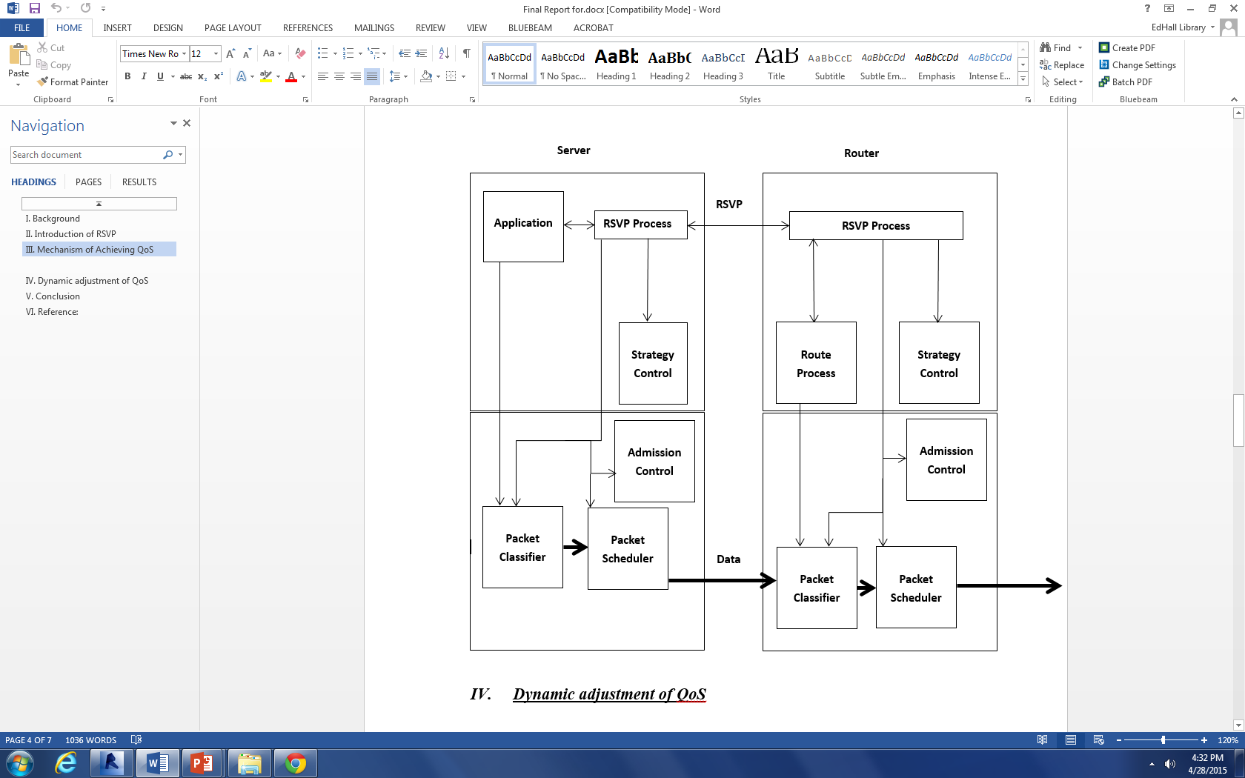
A typical RSVP communication model

Slide 7
Outline
Introduction of RSVP
Mechanism of Achieving QoS
Dynamic adjustment of QoS
Conclusion

Slide 8
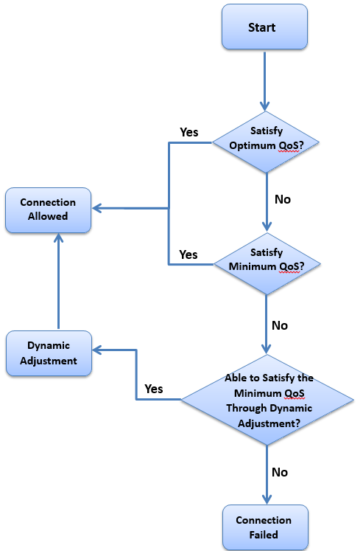
The flow chart for dynamic control algorithm

Slide 9
Outline
Introduction of RSVP
Mechanism of Achieving QoS
Dynamic adjustment of QoS
Conclusion

Slide 10
Conclusion
The current RSVP is only responsible for transporting data, but not actually participates in the strategy control, which in turn required the local strategy control and flow control modular to get involved.
Only limited inside small Intranet
Its expansibility is still under researching.

Slide 11
Thank you!
Questions?

